Slide 1
Wine Quality Project
Anshul Bhardwaj

Slide 2
Problem Statement
To build a Machine Learning Model which will classify a wine in High quality or Low Quality using various input features.

Slide 3
Clients / Intended Audience
This model can be used by anyone who wants to what makes a good wine, which ingredients affect the wine quality the most.
This model can be used by anyone who wants to find out quality of wine given the input variables.

Slide 4
Dataset
The dataset used for this project is taken from UCI Machine Learning repository.
https://archive.ics.uci.edu/ml/datasets/wine+quality
The dataset contains many features such as Fixed acidity, volatile acidity, pH, alcohol, Citric acid, Residual sugar, Chlorides, Free sulfur dioxide, Total Sulfur dioxide, Density and Sulphates

Slide 5
Data Cleaning & Data Wrangling
Duplicate rows removed Original Dataset had 240 duplicate rows. They were removed using the following method:
Dataset had no missing or NaN values
df.drop_duplicates(keep = 'first', inplace = True)

Slide 6
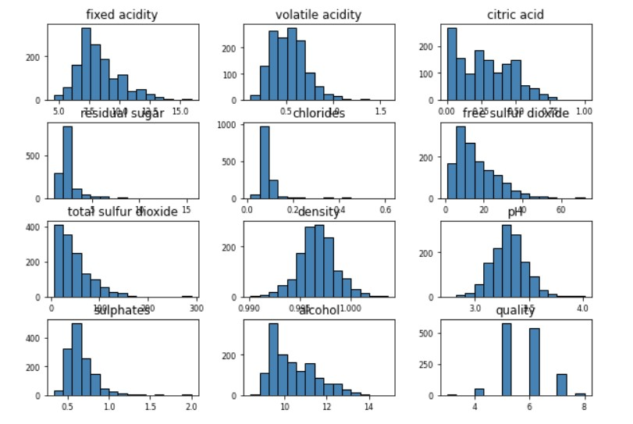
Exploratory Data Analysis
Distribution of Input Features.

Slide 7
Checking for Outliers

Slide 8
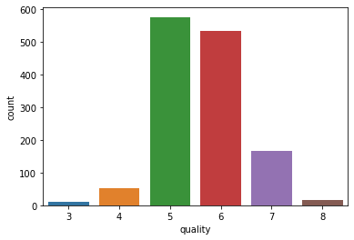
Feature Engineering
In the given Dataset the Target variable ‘Quality’ was in the range of from 3 to 8. As per project’s requirement the Quality features was split into two labels ‘Good’ and ‘Bad’ using the following method.
bins = (2, 6.5, 8)
labels = ['bad', 'good’]
df['quality'] = pd.cut(x = df['quality'], bins = bins, labels = labels)

Slide 9
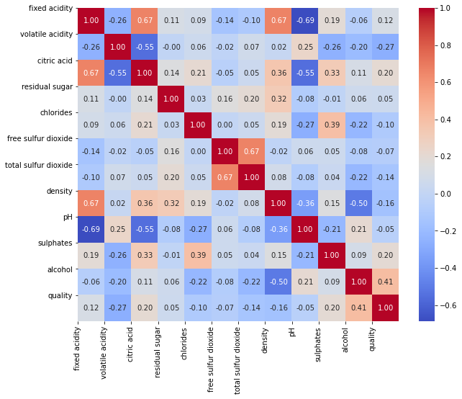
Correlation Matrix of Variables

Slide 10
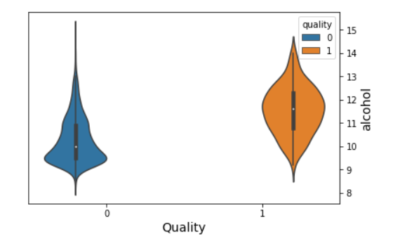
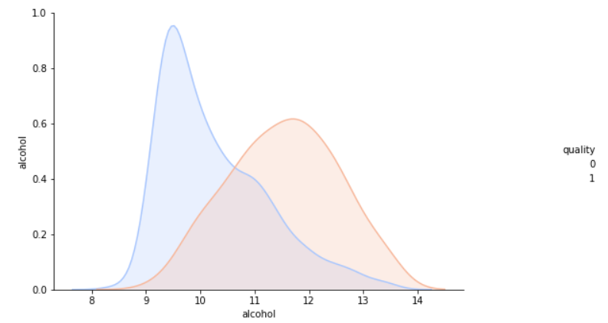
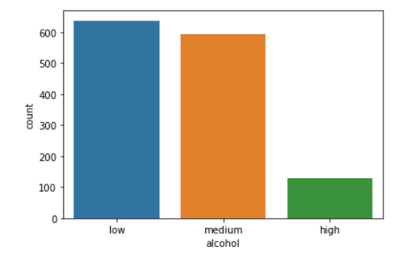
Out of all the input features the distribution of alcohol feature was different for Good and Bad quality. Other input feature showed not much difference in distribution for both Good and Bad Quality.
I decided to further analyze alcohol feature and did some feature engineering on it.
I decided to cut alcohol feature into three segments. Low, Medium and High respectively using the following method.
bins = [0,10,12,16]
labels2 = ['low', 'medium','high’]
df['alcohol'] = pd.cut(x = df['alcohol'], bins = bins, labels = labels2)
Distribution of alcohol after feature engineering ->

Slide 11
Outlier Removal & Data Balancing
I used Statistical method to remove outliers. Any row containing a value having z-score higher than 3 was removed.
from scipy import stats
z = np.abs(stats.zscore(df))
df = df[(z < 3).all(axis=1)]
As the dataset was highly Unbalanced, it used SMOTE for balancing it.
oversample = SMOTE(sampling_strategy=0.5, random_state=42)
X_train, y_train = oversample.fit_resample(X_train0, y_train0)

Slide 12
Machine Learning Model Comparisons
Three different Machine Learning Algorithms were used.
Model | Accuracy | ROC_AUC Score
Logistic Regression | 89.49% | 0.868
Random Forest Classification | 90.8% | 0.850
Xgboost Classifier | 92.24% | 0.887
All models performed similar but Xgboost performed the best with ROC_AUC Score of .887.
Alcohol feature has highest importance.

Slide 13
Future Improvements
A better outlier removal method
More feature Engineering

